Slide 1
Grid
Taught by Yossef Ayman Zedan

Slide 2
What do we really need in CSS to add grid system?
We need a class which has display: flex; inside the CSS. This is exactly the same as the class of row in bootstrap.. So, to add a grid system we use <div class=“row”></div>

Slide 3
How to add columns of the same width
To add columns inside the row class, we use col class. To add classes of col, we can add
<div class="row">
<div class="col">
Col 1
</div>
<div class="col">
Col 2
</div>
<div class="col">
Col 3
</div>
</div>
Now you can check out the web page to find that we have 3 columns of exactly the same width

Slide 4
Setting column width
Now we would love to know how we can edit the width of the column. Same as if I don’t want them all to have the same width.. The maximum number of columns for numbers inside the screen is 12. If we go and add 13 columns, the layout will be broken.
There is from col-1 up to col-12. To find how much this column occupies from the screen, you can use this formula (X/12) x 100. The X variable is the number which the number beside to col- . If we type col-6 and then add two <div class=”col”></div>.
They col classes will have the same width but the col-6 width will not ever change

Slide 5
What about the responsive design
Now we can talk about if I make a column of 12 for the large screen but I want it to have col-6 for the medium.. This is where also we can use the breakpoints. We know about the screen from x-small to the XX-large.
There is col-breakpoint-number. The number can be from 1 to 12 and the breakpoint can be sm, md, lg, xl, xxl. For the xs, we do not type anything.
If I add class <div class=“col-xxl-6”></div>, this column will have width 50% of the screen from more than xxl until we reach the minimum point of the xxl
If I add class <div class=“col-xl-6”></div>, this column will have width 50% of the screen from more than xxl until we reach the minimum point of the xl
So, if we want a column to have a width from more than xxl to xl, we can just use col-xl-
Instead of using col-xxl- col-xl. The same method for any breakpoint

Slide 6
Different width according to the screen
To make different column width according to the size of the screen, we use col-breakpoint-number and Ofcourse we know that. Let’s give a small quiz that you can solve. Hint: add a background color to ensure from the width
Question: build a column that has 12 from largest to xxl, 6 from xxl to xl, 7 from xl to lg, 4 from lg to md, 8 from md to sm and 5 from the small to xs
Answer: <div class="col-xxl-6 col-xl-6 col-lg-7 col-md-4 col-sm-8 col-5"></div>
Now we added many breakpoints inside just one div element

Slide 7
Variable width content
To make a column that has Variable width according to the content, we use col-auto. We can also use a breakpoint like col-md-auto and we can also use responsive grid system that just has variable width for xxl screens
Example: <div class="col-xxl-auto col-xl-5 col-8"></div>

Slide 8
Stacked to horizontal
We want to add a class that has just col class for a specific breakpoint. We know that if we add 2 col, they will have the same width. Now we want them to have col just for a specific screen, we can use col-breakpoint
For example: <div class="row"> <div class="col-sm">col-sm</div>
<div class="col-sm">col-sm</div>
<div class="col-sm">col-sm</div>
</div>
We can also use
<div class="row">
<div class="col-xl col-lg-6 col-4">Col-xl col-lg-6 col-4</div>
</div>

Slide 9
Row columns
Row columns is how we can control the number of columns inside the screen when using just col class. We want to use col but just 2 columns to occupy the screen and if I add the third one, the layout to be broken.
We use :
<div class="row row-cols-3">
<div class=”col”></div>
<div class=”col”></div>
<div class=”col”></div>
</div>
This says that I want to have just 3 columns of the screen, if we add the fourth, the layout will be broken

Slide 10
Row columns variable according to the width of the content
We can also add row-cols-auto that makes all of the col inside variable width according to the content, for example:
<div class="row row-cols-auto">
<div class="col">Column</div>
<div class="col">Column</div>
<div class="col">Column</div>
<div class="col">Column</div>
</div>

Slide 11
Col-number in row-cols-
We can also use col-number inside the row-cols. For example, we have row-cols-4 and we want column to occupy space of two columns, we can simply add col-6.
<div class="row row-cols-4">
<div class="col">Column</div>
<div class="col">Column</div>
<div class="col-6">Column</div>
<div class="col">Column</div>
</div>

Slide 12
Breakpoints inside row-cols
We can use breakpoints to adjust the number of columns according to the width of the screen. To add a breakpoint, we use row-cols-breakpoint-number
For example, <div class="row row-cols-1 row-cols-sm-2 row-cols-md-4">
<div class="col">Column</div>
<div class="col">Column</div>
<div class="col">Column</div>
<div class="col">Column</div>
</div>
From xxl to md, we have 4 columns. From md to sm, 2 columns and from sm to xs, 1 column

Slide 13
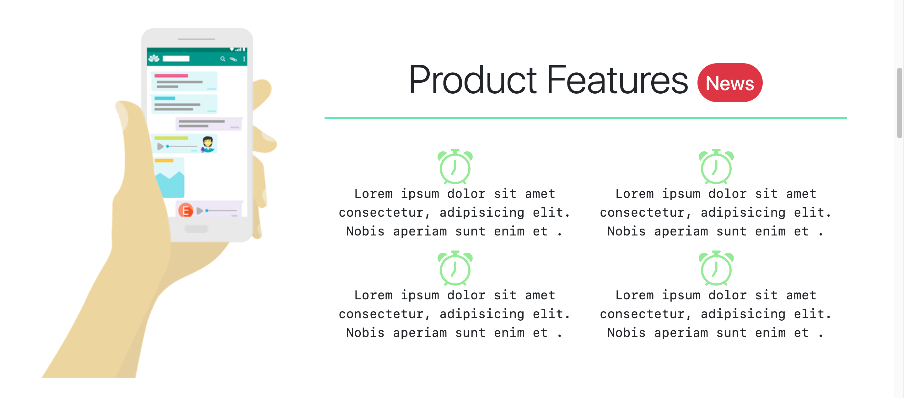
Nesting method
Let’s give an example for the nesting method using the image mentioned below

Slide 14
Nesting method
In this image we have two columns, col-4 and col-8. Inside col-8, we have a new row with two new col-6. the image in the previous slide shows that we can use the nesting method to create advanced and professional grid system
This is the nesting method. For example source code.
<div class="row">
<div class="col-4" style="border: 4px solid red;">Col-4</div>
<div class="col-8" style="border: 4px solid black;">
<div class="row" >
<div class="col-6">Col-6 inside col-8</div>
<div class="col-6">Col-6 inside col-8</div>
</div>
</div>
</div>

